Slide 1
Basic Statistics
Chapter 2 in R

Slide 2
Recap
From last week, you should be able to:
Import data from a CSV file.
Calculate a summary of variables.
Calculate the variance and standard deviation of variables.
Calculate z-scores of variables.
Create a histogram and frequency table.

Slide 3
New Stuff!
Subsetting and tapply
Standard error
Length function → degrees of freedom
Z-score confidence intervals
Effect size and g*power

Slide 4
Subsetting
Subsetting is a way to create a smaller dataset with specific criteria you are looking for.
You should watch the object types and subsetting videos on youtube for lots more information on subsetting.
We are going to cover one way to subset today, but those materials will be important for data screening in a couple weeks.

Slide 5
Subsetting
The easy way:
Use the subset function.
subset(dataset name, WHAT YOU WANT YO?, …)

Slide 6
Subsetting
Logical operators:
Greater than >
Less than <
Equal to ==
Or |
And &

Slide 7
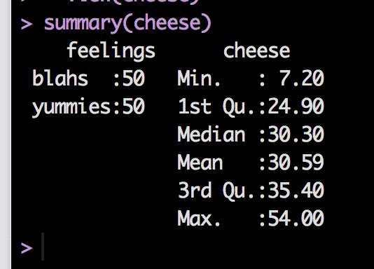
Let’s Try It!
Load the c2.1 cheese data set and name it cheese.
You can see that it created you a factor variable for group.

Slide 8
Let’s Subset!
Remember you have to save the data:
blahs = subset(cheese, feelings == "blahs")
Data name = cheese
Logical
Variable = feelings
Is equal to (==)
Group name = “blahs”
Notice the “”

Slide 9
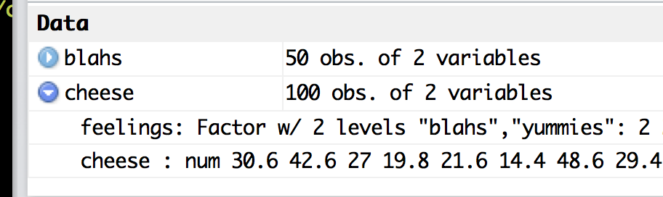
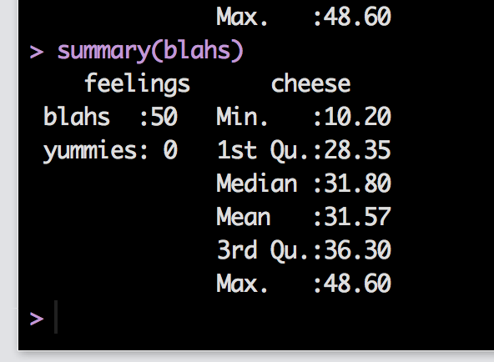
Let’s Subset!
ALWAYS
Check and make sure that did what you expected it to do.

Slide 10
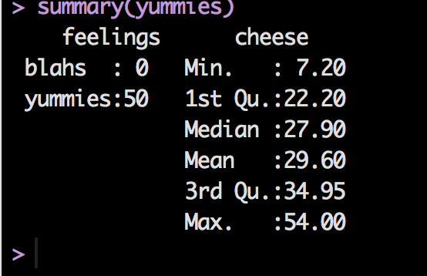
Let’s Subset!
Now, let’s make a dataset for the other group.
yummies = subset(cheese, feelings == "yummies")

Slide 11
Why Subset?
This function allows you to:
Cut out bad data
Only select a specific group of data
But not mess up your original data for the overall analysis.

Slide 12
Tapply
Tapply is a function that allows you to:
Specify grouping variables to split data on
And then calculate descriptives or other functions
It basically subsets the data for you, then calculates the function you include.

Slide 13
Tapply
tapply(
Column to be processed **must be a column,
Column(s) of factor variables to split on **must be factors
Function name)

Slide 14
Tapply
Figure out what function you want to use:
mean = gives you the average
sd = gives you the standard deviation
var = gives you the variance
Etc.

Slide 15
Tapply
Give it a whirl!
tapply(cheese$cheese, cheese$feelings, sd)
tapply(cheese$cheese, cheese$feelings, mean)

Slide 16
Tapply
What if you have two factor variables?!
Let’s talk about levels versus conditions.

Slide 17
Levels
You have one independent variable with different groups = levels.
IV = Gender
Levels: male and female

Slide 18
Conditions
You have two or more independent variables, and their combinations = conditions.
IV = Gender
Levels: male and female
IV = Handedness
Levels: right and left.
Conditions:
Right male, right female, left male, left female

Slide 19
Tapply
Let’s make a fake variable to have two IVs
second = c(rep(1:2, 50))
Let’s try it with two variables:
tapply(cheese$cheese, list(cheese$feelings, second), mean)
Note: if both variables are already in the dataset, be sure they have a dataset name.

Slide 20
Standard Error
Now you can get the SD of levels and conditions of variables.
SE is not a function in base R (lame-o).
But the formula is easy: SD / square root (N).

Slide 21
Standard Error
How can I find N easily?
You can “hard code” it. That means you type in the number directly.
While you are learning, this way is perfectly legit. However, as you get better at R, find ways NOT to do that.
Why? Because then you don’t have to remember to recode it if you delete a participant or add more to the dataset.

Slide 22
Standard Error
length() function.
The length function tells you:
How many things are stored in a variable.
For a vector (i.e. one row of data), you get the number of items – so the number of data points.
HOWEVER! For a data frame (dataset), you get the number of columns.

Slide 23
Standard Error
Since we want to calculate SE for each level/condition separately, we can use the tapply function to figure out how many people are in each group
OR you can use the subsetting function to create separate datasets and figure out how many people are in the dataset by looking at the environment window.

Slide 24
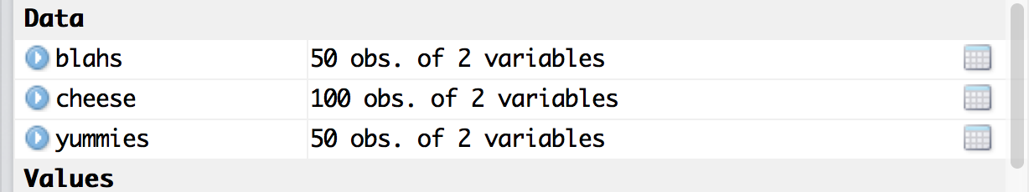
Standard Error
tapply(cheese$cheese, cheese$feelings, length)

Slide 25
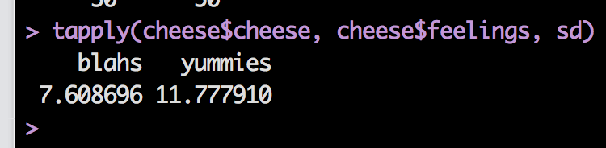
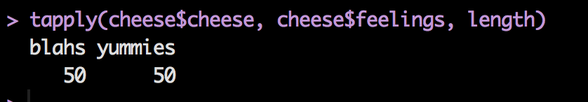
Standard Error
So, we have their SDs
And their lengths

Slide 26
Standard Error
You can just divide!
(but let’s be fancy about it)
sd = tapply(cheese$cheese, cheese$feelings, sd)
N = tapply(cheese$cheese, cheese$feelings, length)
se = sd / sqrt(N)

Slide 27
Length
Don’t forget the df formula
N – 1

Slide 28
Confidence Intervals (z)
Now that we have M and SE, we can calculate confidence intervals.
Formulas:
M + Zcutoff *(SE)
M – Zcutoff *(SE)

Slide 29
Confidence Intervals (z)
Quick note:
You need an upper and a lower (it’s an interval).
R needs the * symbol, it doesn’t know that you multiply ()().

Slide 30
Confidence Intervals (z)
M = tapply(cheese$cheese, cheese$feelings, mean)
M + 1.96*(se)
M - 1.96*(se)
Why 1.96?
Remember we created se a minute ago..

Slide 31
Effect Size!
Effect size boils down to a z-score formula when you are comparing groups:
d = (M group 1 – M group 2) / SD
The tricky part is the SD.
We’ll cover these matched to their specific tests.
But remember the rules listed at the end of the notes as guidelines while you are learning.

Slide 32
G Power!
This program is pretty awesome. We will talk about power for specific tests as we go through them.
But the homework has G*Power, so let’s try it!

Slide 33
G Power!
Test family: t-tests
Statistical test: Means difference between 2 independent populations
Type of power analysis: compute required sample size
Input parameters:
tails – usually we use two
effect size d – enter the Cohen’s d for the two means
a err prob – this is alpha, generally we use .05
power (1-beta) – most people use .80
Allocation ratio = N2 / N1 = sample size group 2 / sample size group 1

Slide 34
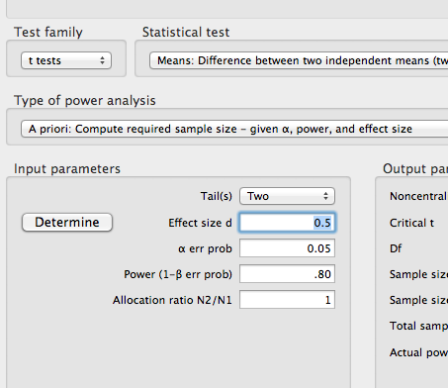

Slide 35
